Slide 1
Rational Agents and Search Problems

Slide 2
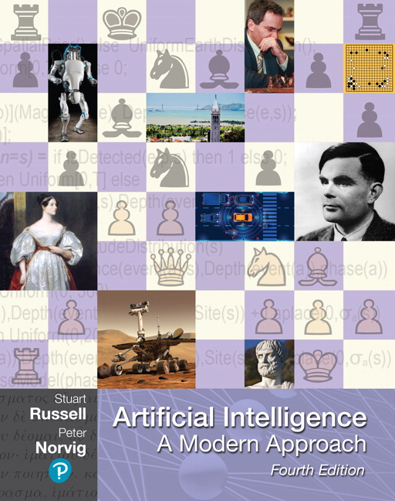
Outline for today’s lecture
Intelligent Agents (AIMA 2.1-2.4)
Task Environments
Formulating Search Problems
Uninformed Search (AIMA 3.1-3.4)

Slide 3
Four views of Artificial Intelligence
In this course, we are going to focus
Thinking humanly | Thinking rationally
Acting humanly | Acting rationally

Slide 4
Agents
An agent is anything that perceives its environment through sensors and can act on its environment through actuators
A percept is the agent’s perceptual inputs at any given instance.

Slide 5
What about your robot?
What actuators does it have?
What sensors does it have?

Slide 6
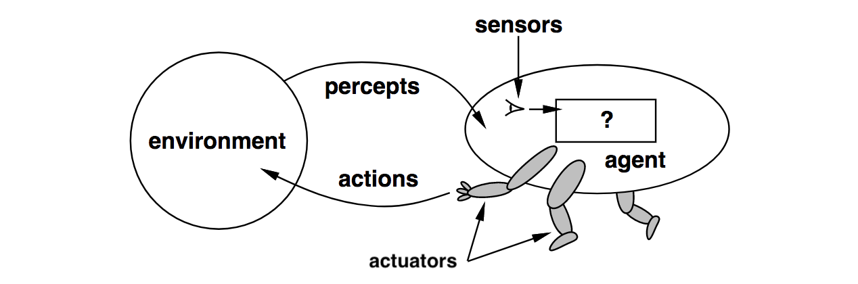
Agents and environments
An agent is specified by an agent function f:P→ a that maps a sequence of percept vectors P to an action a from a set A:
P=[p₀, p₁, … , p_{t}]
A={a₀, a₁, … , a_{k}}
abstract mathematical description
Notes:
Mathematically speaking, we say that an agent’s behavior is described by the agent function that maps any given percept sequence to an action.

Slide 7
Agents
An agent is anything that can be viewed as
perceiving its environment through sensors and
acting upon that environment through actuators
Human agent:
Sensors: eyes, ears, ...
Actuators: hands, legs, mouth, …
Robotic agent:
Sensors: cameras and infrared range finders
Actuators: various motors
Agents include humans, robots, softbots, thermostats, …
Notes:
Thermostats?!?!?! Yes, they are self–regulating and foundational to the field of Control Theory, which was one of the fields that gave raise to AI.

Slide 8

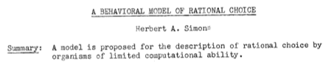
Acting Rationally
Herb Simon was an economist, political scientist and cognitive psychologist, whose primary research interest was decision-making and is best known for his theory of "bounded rationality"
He received the Nobel Prize in Economics in 1978 and the Turing Award in 1975.
Herbert Simon

Slide 9
Acting rationally
Rational behavior: doing the right thing
The right thing: that which is expected to maximize goal achievement, given the available information
Rational agent: An agent is an entity that perceives and acts rationally
This course is about effective programming techniques for designing rational agents

Slide 10
Agent function & program
The agent program runs on the physical architecture to produce f
agent = architecture + program
“Easy” solution: a giant table that maps every possible sequence P to an action a
One small problem: exponential in length of P
Notes:
Internally, the agent function for an artificial agent will be implemented by an agent program.
The agent function is an abstract mathematical description;
The agent program is a concrete implementation, running within some physical system.

Slide 11
Performance measure
How do we know if an agent is acting rationally?
Informally, we expect that it will do the right thing in all circumstances.
How do we know if it’s doing the right thing?
We define a performance measure:
An objective criterion for success of an agent's behavior
given the evidence provided by the percept sequence.
Notes:
Consider an alternative performance measure for the vacuum-cleaner agent. We measure performance by the amount of dirt cleaned up in a single eight-hour shift. With a rational agent, of course, what you ask for is what you get. A rational agent can maximize this performance measure by cleaning up the dirt, then dumping it all on the floor, then cleaning it up again, and so on.

Slide 12
Performance measure - example
A performance measure for a vacuum-cleaner agent might include e.g. some subset of:
+1 point for each clean square in time T
+1 point for clean square, -1 for each move
-1000 for more than k dirty squares
Notes:
Consider an alternative performance measure for the vacuum-cleaner agent. We measure performance by the amount of dirt cleaned up in a single eight-hour shift. With a rational agent, of course, what you ask for is what you get. A rational agent can maximize this performance measure by cleaning up the dirt, then dumping it all on the floor, then cleaning it up again, and so on.

Slide 13
Rational agents
Rational Agent:
For each possible percept sequence P
a rational agent selects an action a
to maximize its performance measure

Slide 14

Is omniscience required?
Notes:
Ideal agent: maximizes actual performance, but needs to be omniscient.
Usually impossible…..
But consider tic-tac-toe agent…
Rationality  Guaranteed Success
Caveat: computational limitations make complete rationality unachievable
design best program for given machine resources

Slide 15
Rationality is not omniscience
Ideal agent: maximizes actual performance, but needs to be omniscient.
Usually impossible…..
But consider tic-tac-toe agent…
Rationality ≠ Guaranteed Success
Caveat: computational limitations make complete rationality unachievable
design best program for given machine resources

Slide 16
Expected value
Rational Agent (initial definition):
For each possible percept sequence P,
a rational agent selects an action a
to maximize its performance measure
Rational Agent (revised definition):
For each possible percept sequence P,
a rational agent selects an action a
that maximizes the expected value of its performance measure
It doesn’t have to know what the actual outcome will be.

Slide 17

Task environments
To design a rational agent we need to specify a task environment
a problem specification for which the agent is a solution
PEAS: to specify a task environment
Performance measure
Environment
Actuators
Sensors

Slide 18
PEAS: Specifying an automated taxi driver
Performance measure:
?
Environment:
?
Actuators:
?
Sensors:
?
Notes:
Performance measure:
safe, fast, legal, comfortable, maximize profits
Environment:
roads, other traffic, pedestrians, customers
Actuators:
steering, accelerator, brake, signal, horn
Sensors:
cameras, sonar, speedometer, GPS

Slide 19
PEAS: Specifying an automated taxi driver
Performance measure:
safe, fast, legal, comfortable, maximize profits
Environment:
roads, other traffic, pedestrians, customers
Actuators:
steering, accelerator, brake, signal, horn
Sensors:
cameras, LiDAR, speedometer, GPS
Notes:
Lidar acronym for light detection and ranging

Slide 20
PEAS: Amazon Prime Air
Performance measure:
?
Environment:
?
Actuators:
?
Sensors:
?
Notes:
https://www.today.com/video/amazon-debuts-new-package-delivery-drone-61414981780
https://nbcnewsencoding-vh.akamaihd.net/i/nbcnews/video/2019/06/tdy_news_costello_amazon_190606_893856774.mp4,,.csmil/master.m3u8?__b__=1000

Slide 21
https://www.today.com/video/amazon-adebuts-new-package-delivery-drone-61414981780

Slide 22
PEAS: Specifying an Amazon delivery drone
Performance measure:
maximize profits - minimize time - obey laws governing airspace restrictions - deliver package to right location - keep package in good condition - avoid accidents - reduce noise - preserve battery life
Environment:
- airspace - obstacles when airborne (other drones, birds, buildings, trees, utility poles)- obstacles when landing (pets, patio furniture, lawnmowers, people, cars)- weather - distances/route information between warehouse and destinations - position of houses, and spaces that are safe for drop-off- package weight
Notes:
Performance measure:
safe, fast, legal, comfortable, maximize profits
Environment:
roads, other traffic, pedestrians, customers
Actuators:
steering, accelerator, brake, signal, horn
Sensors:
cameras, sonar, speedometer, GPS

Slide 23
PEAS: Specifying an Amazon delivery drone
Actuators:
- Propellers and flight control system- Payload actuators: E.g. Arm/basket/claw for picking up, dropping off packages- Lights or signals - Mechanism to announce/verify delivery- Device for delivering packages to customers
Sensors:
GPS - radar/Lidar- altitude sensor- weather sensors (barometer, etc). - gyroscope- accelorometer- camera- rotor senors- weight sensor to recognize package
Notes:
Performance measure:
safe, fast, legal, comfortable, maximize profits
Environment:
roads, other traffic, pedestrians, customers
Actuators:
steering, accelerator, brake, signal, horn
Sensors:
cameras, sonar, speedometer, GPS

Slide 24
The rational agent designer’s goal
abstract mathematical description
Goal of AI practitioner who designs rational agents:
given a PEAS task environment,
Construct agent function f that maximizes the expected value of the performance measure,
Design an agent program that implements f on a particular architecture
concrete implementation
Notes:
The agent function is an abstract mathematical description;
The agent program is a concrete implementation, running within some physical system.

Slide 25
Environment types: Definitions 1
Fully observable (vs. partially observable): An agent's sensors give it access to the complete state of the environment at each point in time.
Deterministic (vs. stochastic): The next state of the environment is completely determined by the current state and the action executed by the agent.
If the environment is deterministic except for the actions of other agents, then the environment is strategic.
Episodic (vs. sequential): The agent's experience is divided into atomic "episodes" during which the agent perceives and then performs a single action, and the choice of action in each episode does not depend on any previous action. (example: classification task)

Slide 26
Environment types: Definitions 2
Static (vs. dynamic): The environment is unchanged while an agent is deliberating.
The environment is semidynamic if the environment itself does not change with the passage of time but the agent's performance score does.
Discrete (vs. continuous): A limited number of distinct, clearly defined percepts and actions.
Single agent (vs. multiagent): An agent operating by itself in an environment.
Notes:
Multi-agent: Does agent A (the taxi driver) need to treat object B (another vehicle) as an agent, or can it merely be treated as an object behaving according to the laws of physics? Is B’s behavior best described as maximizing a performance measure? Does that also depend on agent A’s behavior? Is it competitive or cooperative?
CCB – write the next slide on the board

Slide 27
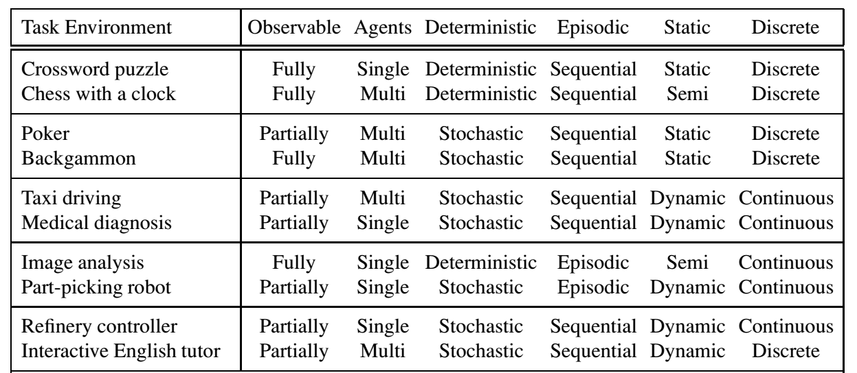
Examples

Slide 28
The Hardest Environment
The hardest case is
Continuous
Partially Observable
Stochastic
Continuous
Multiagent
Unknown Outcomes

Slide 29
Environment Restrictions for Now
We will assume environment is
Static
Fully Observable
Deterministic
Discrete

Slide 30
Problem Solving Agents & Problem Formulation
AIMA 3.1-3.2

Slide 31
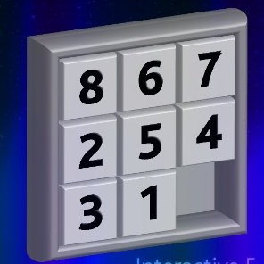

Example search problem: 8-puzzle
Formulate goal
Pieces to end up in order as shown…
Formulate search problem
States: configurations of the puzzle (9! configurations)
Actions: Move one of the movable pieces (≤4 possible)
Performance measure: minimize total moves
Find solution
Sequence of pieces moved: 3,1,6,3,1,…
Notes:
Sometimes a performance measure can be formulated in whether an agent satisfies a goal.
This Is called a sliding block puzzle. This instance is an 8-puzzle.
9!/2 = 181k
Family of sliding block puzzles are NP complete. 15 block puzzle (4x4 board has 1.3 trillion states (1.3*10^12).
5x5 board has 10^25 states.

Slide 32
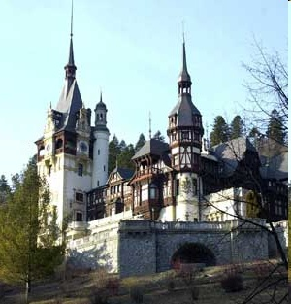
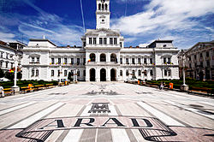
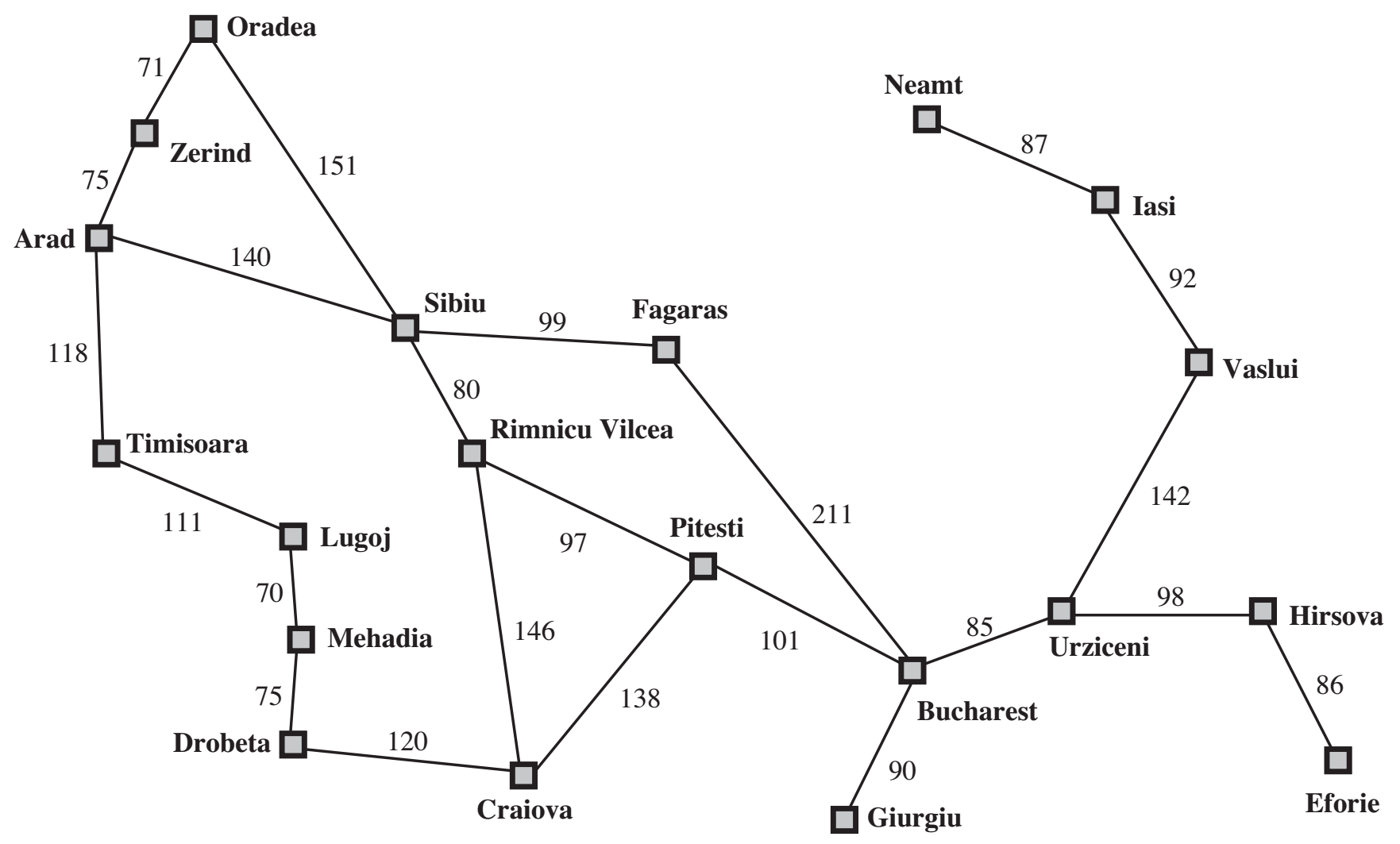
Example search problem: holiday in Romania
You are here
You need to be here
Notes:
Conveniently has nodes with unique first letters and nearly all letters of the alphabet
Oradea
Zerind
Sibiu Arad

Slide 33
Holiday in Romania
On holiday in Romania; currently in Arad
Flight leaves tomorrow from Bucharest
Formulate goal
Be in Bucharest
Formulate search problem
States: various cities
Actions: drive between cities
Performance measure: minimize travel time / distance
Find solution
Sequence of cities; e.g. Arad, Sibiu, Fagaras, Bucharest, …

Slide 34
More formally, a problem is defined by:
States: a set S
An initial state s_{i}∈S
Actions: a set A
∀ s Actions(s) = the set of actions that can be executed in s, that are applicable in s.
Transition Model: ∀ s∀ a∈Actions(s) Result(s, a) → s_{r}
s_{r} is called a successor of s
{s_{i} }∪ Successors(s_{i} )* = state space
Path cost (Performance Measure): Must be additive
e.g. sum of distances, number of actions executed, …
c(x,a,y) is the step cost, assumed ≥ 0
(where action a goes from state x to state y)
Goal test: Goal(s)
Can be implicit, e.g. checkmate(s)
s is a goal state if Goal(s) is true
Notes:
INITIAL STATE
2) The initial state that the agent starts in. For example, the initial state for our agent in Romania might be described as In(Arad).
ACTIONS
3) A description of the possible actions available to the agent. Given a particular state s, ACTIONS(s) returns the set of actions that can be executed in s. We say that each of APPLICABLE these actions is applicable in s. For example, from the state In(Arad), the applicable actions are {Go(Sibiu), Go(Timisoara), Go(Zerind)}.
TRANSITION MODEL
4) A description of what each action does; the formal name for this is the transition model, specified by a function RESULT(s, a) that returns the state that results from SUCCESSOR doing action a in state s. We also use the term successor to refer to any state reachable from a given state by a single action.2 For example, we have RESULT(In(Arad),Go(Zerind)) = In(Zerind).
1) STATE SPACE
Together, the initial state, actions, and transition model implicitly define the state space of the problem—the set of all states reachable from the initial state by any sequence GRAPH of actions. The state space forms a directed network or graph in which the nodes are states and the links between nodes are actions. (The map of Romania shown in Figure 3.2 can be interpreted as a state-space graph if we view each road as standing for two driving actions, one in each direction.)
5) PATH A path in the state space is a sequence of states connected by a sequence of actions.
PATH COST A path cost function that assigns a numeric cost to each path. The problem-solving agent chooses a cost function that reflects its own performance measure. For the agent trying to get to Bucharest, time is of the essence, so the cost of a path might be its length in kilometers. In this chapter, we assume that the cost of a path can be described as the sum of the costs of the individual actions along the path. STEP COST The step cost of taking action a in state s to reach state s is denoted by c(s, a, s). The step costs for Romania are shown in Figure 3.2 as route distances. We assume that step costs are nonnegative.
6) GOAL TEST • The goal test, which determines whether a given state is a goal state. Sometimes there is an explicit set of possible goal states, and the test simply checks whether the given state is one of them. The agent’s goal in Romania is the singleton set {In(Bucharest)}. Sometimes the goal is specified by an abstract property rather than an explicitly enumerated set of states. For example, in chess, the goal is to reach a state called “checkmate,” where the opponent’s king is under attack and can’t escape.

Slide 35
Solutions & Optimal Solutions
A solution is a sequence of actions from the initial state to a goal state.
Optimal Solution: A solution is optimal if no solution has a lower path cost.

Slide 36
Art: Formulating a Search Problem
Decide:
Which properties matter & how to represent
Initial State, Goal State, Possible Intermediate States
Which actions are possible & how to represent
Operator Set: Actions and Transition Model
Which action is next
Path Cost Function
Formulation greatly affects combinatorics of search space and therefore speed of search
Notes:
state: compare to “world state” that includes every aspect of reality; each state corresponds to many world states
world states=states of the actual world; represent abstraction/simplification; this is modeling; have to formulate well to solve problem efficiently
use state for representation of that part of world state that matters
use operator for representation of those aspects of actions that matter
more formally on next slide

Slide 37
Example: 8-puzzle
States??
Initial state??
Actions??
Transition Model??
Goal test??
Path cost??
Notes:
CCB – ask students to give answer, write their answers on the board.

Slide 38
Example: 8-puzzle
States?? List of 9 locations- e.g., [7,2,4,5,-,6,8,3,1]
Initial state?? [7,2,4,5,-,6,8,3,1]
Actions?? {Left, Right, Up, Down}
Transition Model?? ...
Goal test?? Check if goal configuration is reached
Path cost?? Number of actions to reach goal

Slide 39
Example: 8-puzzle
States?? List of 9 locations- e.g., [7,2,4,5,-,6,8,3,1]
Initial state?? [7,2,4,5,-,6,8,3,1]
Actions?? {Left, Right, Up, Down}
Transition Model?? ...
Goal test?? Check if goal configuration is reached
Path cost?? Number of actions to reach goal
Notes:
Transition model: given a state and an action, this returns the resulting state. For example, if we apply left to the start state, the resulting state has 5 and the blank switched.

Slide 40
Hard subtask: Selecting a state space
Real world is absurdly complex
State space must be abstracted for problem solving
(abstract) State = set (equivalence class) of real world states
(abstract) Action = equivalence class of combinations of real world actions
e.g. Arad → Zerind represents a complex set of possible routes, detours, rest stops, etc
The abstraction is valid if the path between two states is reflected in the real world
Each abstract action should be “easier” than the real problem

Slide 41
Outline for today’s lecture
Intelligent Agents
Task Environments
Formulating Search Problems
Search Fundamentals (AIMA 3.3)

Slide 42
Useful Concepts
State space: the set of all states reachable from the initial state by any sequence of actions
When several operators can apply to each state, this gets large very quickly
Might be a proper subset of the set of configurations
Path: a sequence of actions leading from one state s_{j} to another state s_{k}
Frontier: those states that are available for expanding (for applying legal actions to)
Solution: a path from the initial state s_{i} to a state s_{f} that satisfies the goal test

Slide 43
Basic search algorithms: Tree Search
Generalized algorithm to solve search problems
Enumerate in some order all possible paths from the initial state
Here: search through explicit tree generation
ROOT= initial state.
Nodes in search tree generated through transition model
Tree search treats different paths to the same node as distinct

Slide 44
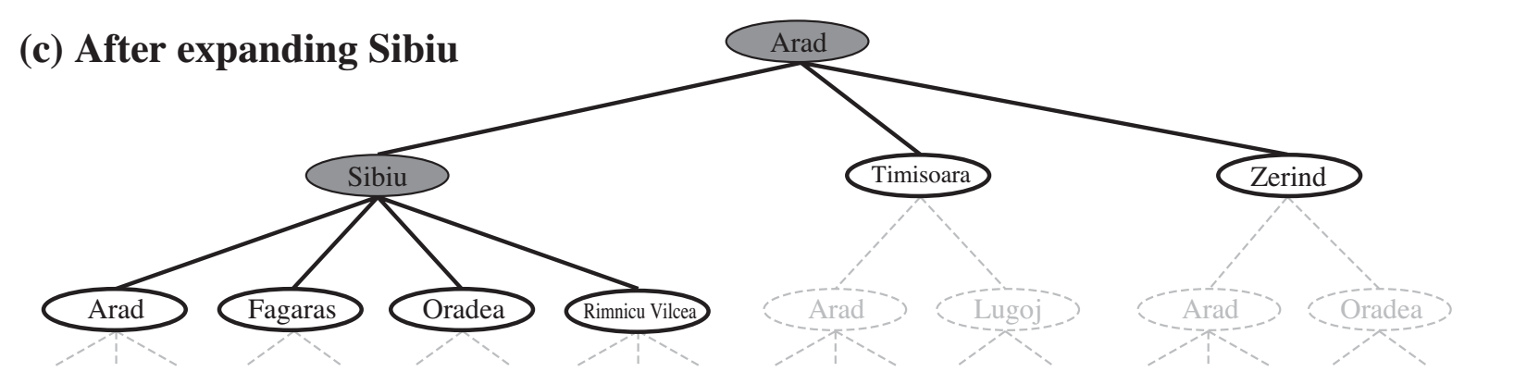
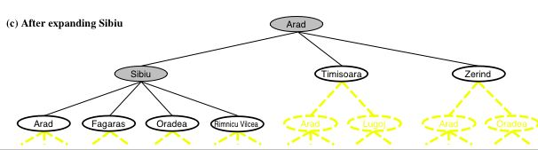
Generalized tree search
function TREE-SEARCH(problem, strategy) return a solution or failure
Initialize frontier to the initial state of the problem
do
if the frontier is empty then return failure
choose leaf node for expansion according to strategy & remove from frontier
if node contains goal state then return solution
else expand the node and add resulting nodes to the frontier
Determines search process!!
44
Notes:
Shaded nodes are the ones that have been expanded
Nodes that have been generated by not yet expanded are outlined in bold.
Others are in dashed yellow lines
There’s a loop if we expand Arad again. Is that good

Slide 45
8-Puzzle: States and Nodes
A state is a (representation of a) physical configuration
A node is a data structure constituting part of a search tree
Also includes parent, children, depth, path cost g(x)
Here node= <state, parent-node, children, action, path-cost, depth>
States do not have parents, children, depth or path cost!
The EXPAND function
uses the Actions and Transition Model to create the corresponding states
creates new nodes,
fills in the various fields
Node
State
parent
Action= Up
Cost = 6
Depth = 6
7 | 2 | 4
5 | 6 | 1
8 | 3
state
children
Notes:
For each node n of the tree, we have a structure that contains four components:
• n.STATE: the state in the state space to which the node corresponds;
• n.PARENT: the node in the search tree that generated this node;
• n.ACTION: the action that was applied to the parent to generate the node;
• n.PATH-COST: the cost, traditionally denoted by g(n), of the path from the initial state to the node, as indicated by the parent pointers.
* n.CHILDREN (optional) often used as a function.

Slide 46
8-Puzzle Search Tree
(Nodes show state, parent, children - leaving Action, Cost, Depth Implicit)
7 | 2 | 4
5 |  | 6
8 | 3 | 1
Suppressing useless “backwards” moves
7 | 2 | 4
 | 5 | 6
8 | 3 | 1
7 |  | 4
5 | 2 | 6
8 | 3 | 1
7 | 2 | 4
5 | 6
8 | 3 | 1
 | 2 | 4
7 | 5 | 6
8 | 3 | 1
7 | 2 | 4
8 | 5 | 6
 | 3 | 1
 | 7 | 4
5 | 2 | 6
8 | 3 | 1
7 | 4
5 | 2 | 6
8 | 3 | 1
7 | 2
5 | 6 | 4
8 | 3 | 1
7 | 2 | 4
5 | 6 | 1
8 | 3

Slide 47
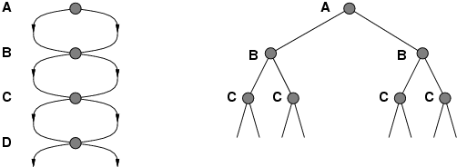
Problem: Repeated states
Failure to detect repeated states can turn a linear problem into an exponential one!
Notes:
? … Following redundant paths can cause a tractable problem to become intractable.
To avoid redundantly expanding the same node, we augment the TREE-SEARCH algorithm with a data structure called the explored set (AKA the closed list), which remembers every expanded

Slide 48
Solution: Graph Search!
S
B
S
B
C
C
C
S
B
S
State Space
Search Tree
Graph search
Simple Mod from tree search: Check to see if a node has been visited before adding to search queue
must keep track of all possible states (can use a lot of memory)
e.g., 8-puzzle problem, we have 9!/2 ≈182K states

Slide 49
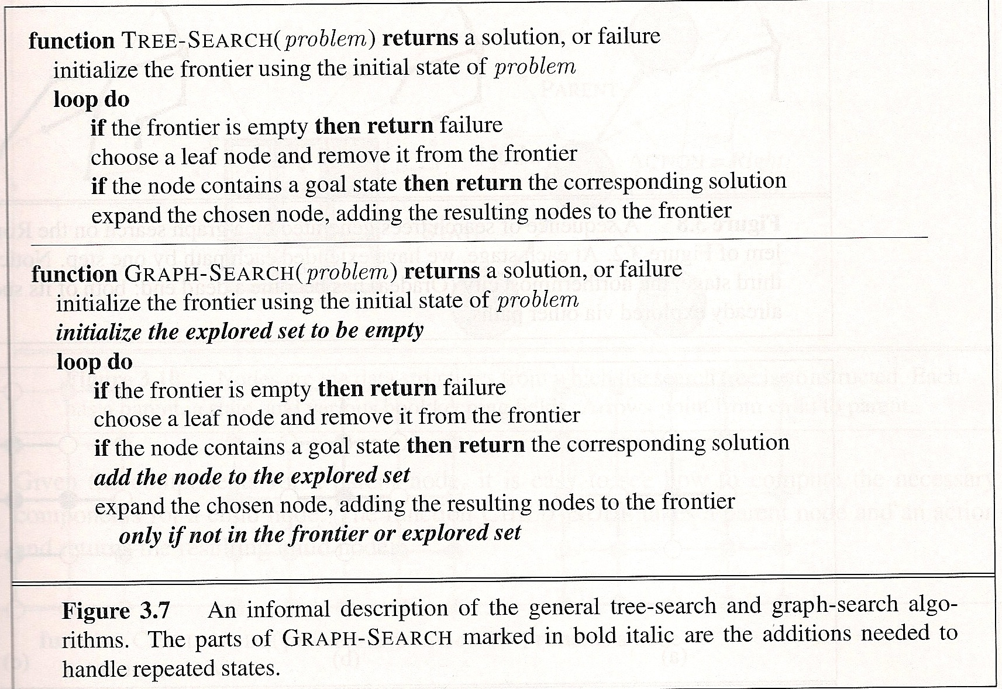
Graph Search vs Tree Search
Notes:
The graph search algorithm is a simple modification of the tree search algorithm. Differences are highlighted with the boxes.

Slide 50
Uninformed Search Strategies
AIMA 3.3-3.4

Slide 51
Uninformed search strategies:
AKA “Blind search”
Uses only information available in problem definition
Informally:
Uninformed search: All non-goal nodes in frontier look equally good
Informed search: Some non-goal nodes can be ranked above others.
51

Slide 52
Search Strategies
Review: Strategy = order of tree expansion
Implemented by different queue structures (LIFO, FIFO, priority)
Dimensions for evaluation
Completeness- always find the solution?
Optimality - finds a least cost solution (lowest path cost) first?
Time complexity - # of nodes generated (worst case)
Space complexity - # of nodes simultaneously in memory (worst case)
Time/space complexity variables
b, maximum branching factor of search tree
d, depth of the shallowest goal node
m, maximum length of any path in the state space (potentially ∞)
Notes:
Ask students: What does LIFO stand for? What does FIFO stand for?
Which is a Stack? (LIFO)

Slide 53
Introduction to space complexity
You know about:
“Big O” notation
Time complexity
Space complexity is analogous to time complexity
Units of space are arbitrary
Doesn’t matter because Big O notation ignores constant multiplicative factors
Plausible Space units:
One Memory word
Size of any fixed size data structure
For example, size of fixed size node in search tree

Slide 54
Review: Breadth-first search
Idea:
Expand shallowest unexpanded node
Implementation:
frontier is FIFO (First-In-First-Out) Queue:
Put successors at the end of frontier successor list.
Image credit: Dan Klein and Pieter Abbeel
http://ai.berkeley.edu

Slide 55
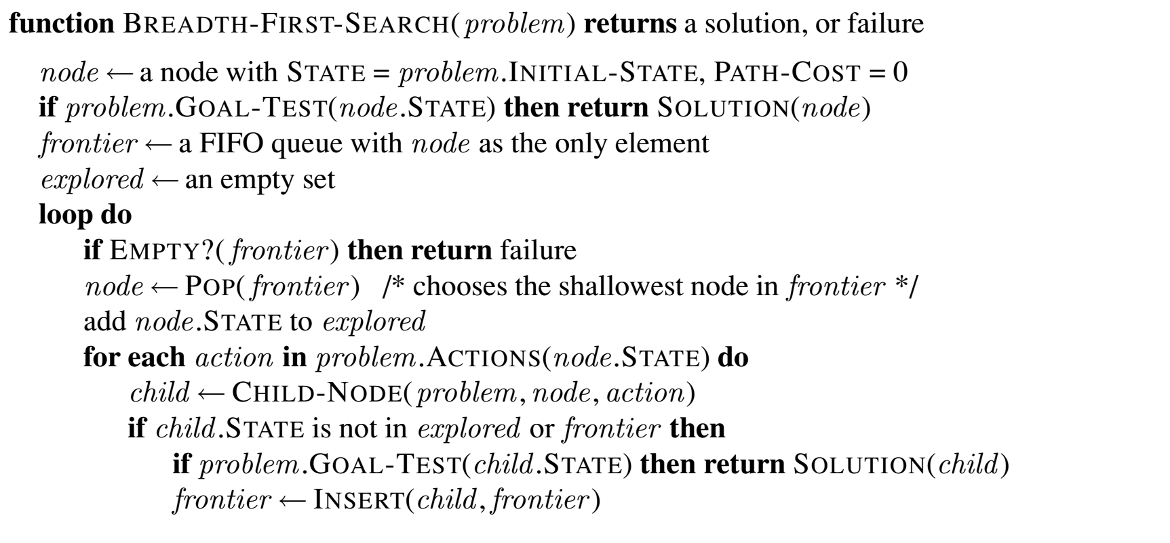
Breadth-first search (simplified)
Position within queue of new items determines search strategy
Subtle: Node inserted into queue only after testing to see if it is a goal state
Notes:
Subtlty: If the algorithm were to apply the goal test to nodes when selected for expansion, rather than when generated, the whole layer of nodes at depth d would be expanded before the goal was detected and the time complexity would be O(b^{d+1}).

Slide 56
Breadth-first search (simplified)
function BREADTH-FIRST-SEARCH(problem) returns a solution, or failure
node <- a node with STATE = problem.INITIAL-STATE, PATH-COST=0
if problem.GOAL-TEST(node.STATE) then return SOLUTION(node)
frontier <- a FIFO queue with node as the only element
loop do
if EMPTY?(frontier) then return failure
node <- POP(frontier) // chooses the shallowest node in frontier
add node.STATE to explored
for each action in problem.ACTIONS(node.STATE) do
child <- CHILD-NODE(problem, node, action)
if problem.GOAL-TEST(child.STATE) then return SOLUTION(child)
frontier <- INSERT(child, frontier)
From Figure 3.11 Breadth-first search (ignores loops, repeated nodes)
Position within queue of new items determines search strategy
Subtle: Node inserted into queue only after testing to see if it is a goal state

Slide 57
Properties of breadth-first search
Complete? Yes (if b is finite)
Time Complexity? 1+b+b²+b³+… +b^{d} = O(b^{d})
Space Complexity? O(b^{d}) (keeps every node in memory)
Optimal? Yes, if cost = 1 per step (not optimal in general)
b: maximum branching factor of search tree
d: depth of the least cost solution
m: maximum depth of the state space (∞)
Notes:
Draw time complexity tree on board.
An exponential complexity bound such as O(b^d) is SCARY!
Would this be optimal for the Romanian Map example? No.
Would this be optimal for the 8-puzzle

Slide 58
Exponential Space (and time) Not Good...
Exponential complexity uninformed search problems cannot be solved for any but the smallest instances.
(Memory requirements are a bigger problem than execution time.)
Fig 3.13 Assumes b=10, 1M nodes/sec, 1000 bytes/node
DEPTH | NODES | TIME | MEMORY
2 | 110 | 0.11 milliseconds | 107 kilobytes
4 | 11110 | 11 milliseconds | 10.6 megabytes
6 | 10⁶ | 1.1 seconds | 1 gigabytes
8 | 10⁸ | 2 minutes | 103 gigabytes
10 | 10¹⁰ | 3 hours | 10 terabytes
12 | 10¹² | 13 days | 1 petabytes
14 | 10¹⁴ | 3.5 years | 99 petabytles
58
Notes:
Two lessons can be learned from Figure 3.13.
1) the memory requirements are a bigger problem for breadth-first search than is the execution time. One might wait 13 days for the solution to an important problem with search depth 12, but no personal computer has the petabyte of memory it would take. Fortunately, other strategies require less memory.
2) time is still a major factor. If your problem has a solution at depth 16, then (given our assumptions) it will take about 350 years for breadth-first search (or indeed any uninformed search) to find it. In general, exponential-complexity search problems cannot be solved by uninformed methods for any but the smallest instances.

Slide 59

Review: Depth-first search
Idea:
Expand deepest unexpanded node
Implementation:
frontier is LIFO (Last-In-First-Out) Queue:
Put successors at the front of frontier successor list.
Image credit: Dan Klein and Pieter Abbeel
http://ai.berkeley.edu

Slide 60
Properties of depth-first search
Complete? No: fails in infinite-depth spaces, spaces with loops
Modify to avoid repeated states along path
→ complete in finite spaces
Time? O(b^{m}): terrible if m is much larger than d
but if solutions are dense, may be much faster than breadth-first
Space? O(b*m), i.e., linear space!
Optimal? No
b: maximum branching factor of search tree
d: depth of the least cost solution
m: maximum depth of the state space (∞)

Slide 61
Depth-first vs Breadth-first
Use depth-first if
Space is restricted
There are many possible solutions with long paths and wrong paths are usually terminated quickly
Search can be fine-tuned quickly
Use breadth-first if
Possible infinite paths
Some solutions have short paths
Can quickly discard unlikely paths

Slide 62
Outline for today’s lecture
Formulating Search Problems – An Example
Search Fundamentals
Introduction to Uninformed Search
Review of Breadth first and Depth-first search
Iterative deepening search (AIMA 3.4.4-5)
Strange Subroutine: Depth-limited search
Depth-limited search + iteration = WIN!!

Slide 63
Search Conundrum
Breadth-first
☑ Complete,
☑ Optimal ☒ but uses O(b^{d}) space
Depth-first
☒ Not complete unless m is bounded
☒ Not optimal
☒ Uses O(b^{m}) time; terrible if m >> d
☑ but only uses O(b∗m) space
How can we get the best of both?
63
Notes:
1. Breadth-first only for small spaces.
2. Depth-first only for known solution depth and admissibility not important.

Slide 64
Depth-limited search: A building block
Depth-First search but with depth limit l.
i.e. nodes at depth l have no successors.
No infinite-path problem!
If l = d (by luck!), then optimal
But:
If l < d then incomplete ☹
If l > d then not optimal ☹
Time complexity:
Space complexity: ☺
64

Slide 65
Iterative deepening search
A general strategy to find best depth limit l.
Key idea: use Depth-limited search as subroutine, with increasing l.
For l = 0 to ∞ do
depth-limited-search to level l
if it succeeds
then return solution
Complete & optimal: Goal is always found at depth d, the depth of the shallowest goal-node.
Could this possibly be efficient?
`
CIS 521 - Intro to AI
65

Slide 66
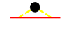
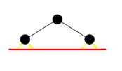
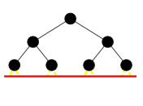
Nodes constructed at each deepening
Depth 0: 0 (Given the node, doesn’t construct it.)
Depth 1: b¹ nodes
Depth 2: b nodes + b² nodes
Depth 3: b nodes + b² nodes + b³ nodes
…

Slide 67
Total nodes constructed:
Depth 0: 0 (Given the node, doesn’t construct it.)
Depth 1: b¹ = b nodes
Depth 2: b nodes + b² nodes
Depth 3: b nodes + b² nodes + b³ nodes
…
Suppose the first solution is the last node at depth 3:
Total nodes constructed:
3*b nodes + 2*b² nodes + 1*b³ nodes

Slide 68
ID search, Evaluation II: Time Complexity
More generally, the time complexity is
(d)b + (d-1)b² + … + (1)b^{d} = O(b^{d})
As efficient in terms of O(…) as Breadth First Search:
b + b² + … + b^{d} = O(b^{d})
68

Slide 69
ID search, Evaluation III
Complete: YES (no infinite paths) ☺
Time complexity:
Space complexity: ☺
Optimal: YES if step cost is 1. ☺
CIS 521 - Intro to AI
69

Slide 70
Summary of algorithms
Criterion | Breadth-First | Depth-First | Depth-limited | Iterative deepening
Complete? | YES | NO | NO | YES
Time | b^{d} | b^{m} | b^{l} | b^{d}
Space | b^{d} | bm | bl | bd
Optimal? | YES | NO | NO | YES

